Slide 1



Slide 2


Social Services- Current Programs
Emergency Shelter
Renewing Hope
Client Services
Housing Navigation Center
Emergency Shelter Case Management

Slide 3

Emergency Shelter
Opens at 2:30 pm, Exit at 7:00 am
400 beds
First come, first serve; unless part of a program
Pets are allowed
Allowed 1 gallon bag with change of clothes, toiletries
Ability to provide toiletries if needed
Access to a personal combination locker for belongings
Access to a personal combination phone locker
Access to Case Management Services

Slide 4
Renewing Hope…for Men
Our Intensive Case Management services help clients work towards sustainability and independence through accountability and client-centered, trauma-informed services
90-day program
Daily check-ins and Education
Three meals a day (Track II)
Obtaining documentation
Job search, access to computers
Medical/Mental/Dental
Class Topics Include…
Job Readiness
Health & Wellness
Financial Literacy & Budgeting
Life Skills
Substance Use Education
Mock Interviews
Coping Skills
Stress Management
Resume Building

Slide 5

Client Services
Resources and referrals
Clarity cards
Toiletries
Clothing
Women’s Hygiene products
Adult Diapers
Children's clothing
Coats and warm clothing in winter
Chapstick, sunblock, hats, and visors in summer
Bags, purses, wallets, belts, glasses
Work attire
Narcan
Fentanyl test strips
Xylazine test strips
Liaison to case management services
May provide case management services
And more…

Slide 6

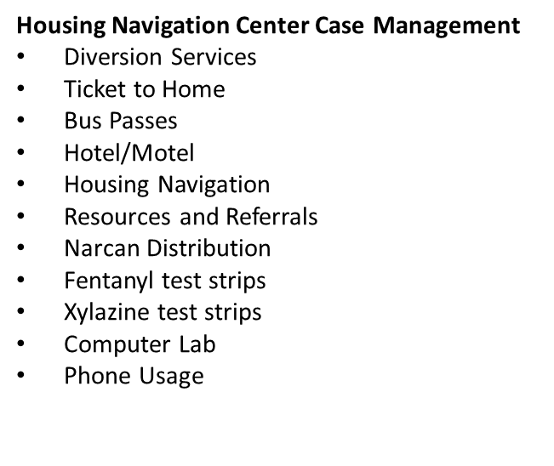

Housing Navigation Center
Operation Home Case Management
Rapid Rehousing
Permanent Supportive Housing
Chronic Homeless Case Management
Landlord Engagement
Resource and Referrals
Rental Assistance
Deposit Assistance
Child Care Assistance
Job Search Assistance
Household items
Progressive Engagement
Basic Life Skills
Supportive Services
In Home Case Management

Slide 7

Emergency Shelter Case Management
Housing First Principles
Trauma Informed
Client Centered
Designated Beds Program
Individual Service Plans
Budgeting assistance
Rapport Building
Medical/Mental/Dental navigation
Social Security Assistance
ID Assistance
Birth Certificate Assistance
Insurance- Medicaid/Medicare
Access to Services
Resource and Referral
And More…

Slide 8

Additional CCSN Programs
Community Meal
  10am daily
Food Pantry
  Mon-Fri 8am-2pm
Women, Infants and Children (WIC)
  Mon-Fri 8am-4pm
Migration and Refugee Services
Meals on Wheels

Slide 9


